Slide 1
Cash Flow Analysis
APSC 221 – Week 2
Summer 2024

Slide 2
Example – Drawing a Cash Flow Diagram
Draw a cash flow diagram based on these personal expenses:
Monthly income, received at the end of the month ($2200)
Rent, paid at the end of the month ($1200)
Weekly food and entertainment ($150)
Cell phone bill, due at the end of the 1st week of each month ($50)
Credit card payment, due at the end of the 2nd week of each month ($300)

Slide 3
If your credit card and phone company offered to move your payment date, how would you determine if it is beneficial to do so?

Slide 4
Review – Equivalence Definitions
Mathematical Equivalency
The calculations we are conducting in this course to equate present and future values.
Decisional Equivalency
- A decision maker is indifferent between money now or in the future.
Market Equivalency
A decision maker can exchange cash flows at zero cost (ie, ignore administrative costs)

Slide 5
Process for Mathematical Equivalency
Use this procedure to compare different cash flow scenarios:
Draw a cash flow diagram for each option.
Use mathematical equivalence to transfer all cash flows to a common point in time.
Compare the options based on their equivalent values at the common point in time.

Slide 6
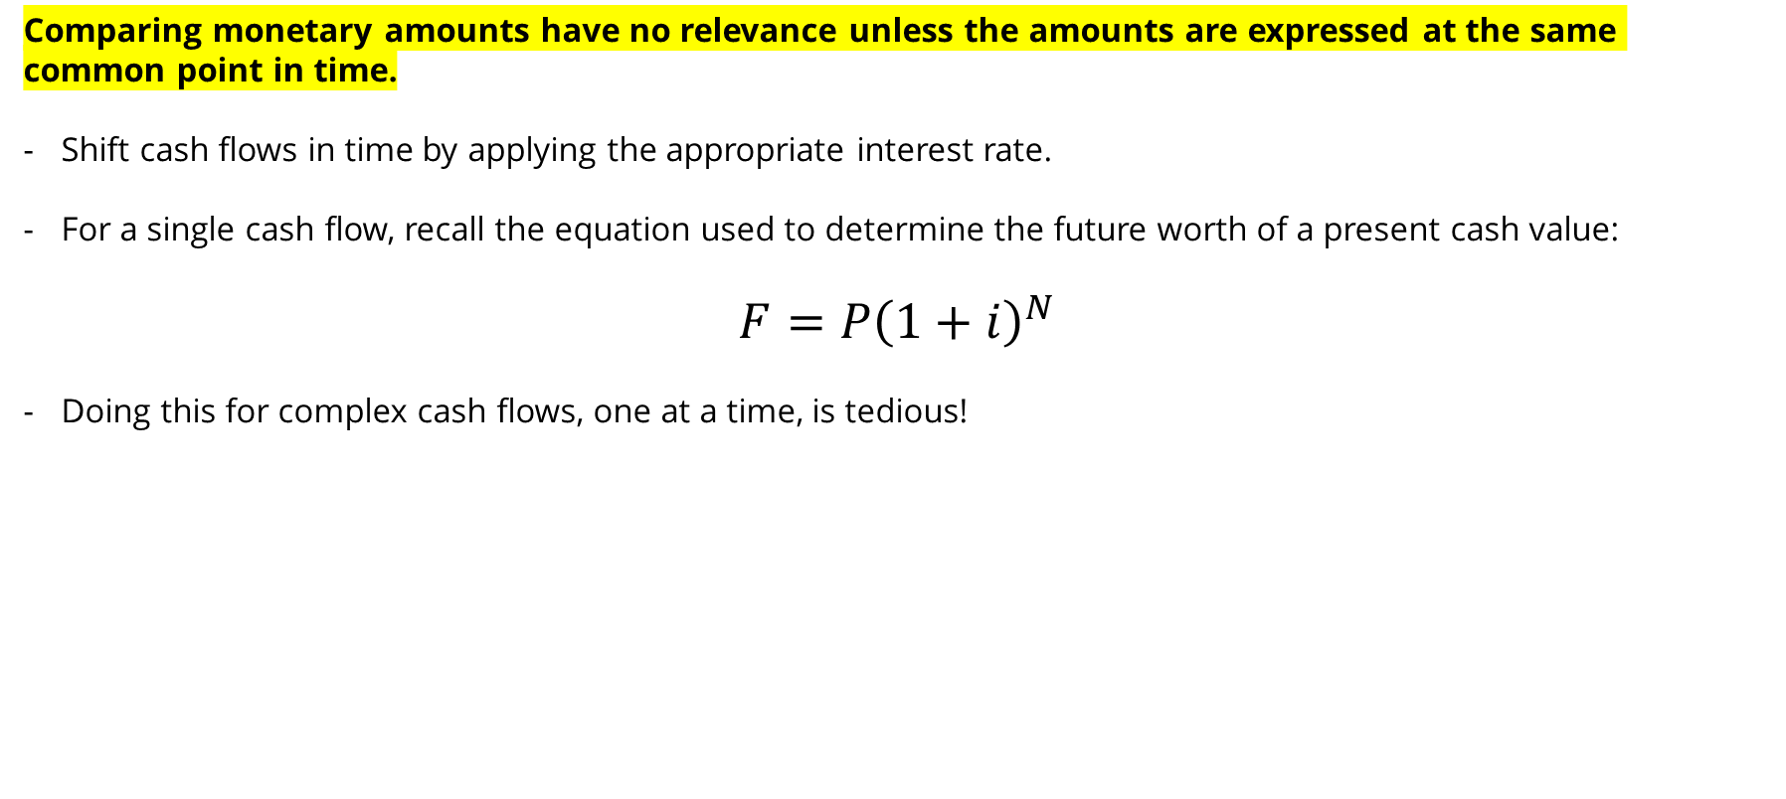
Comparing Cash Flows in Time
Comparing monetary amounts have no relevance unless the amounts are expressed at the same common point in time.
Shift cash flows in time by applying the appropriate interest rate.
For a single cash flow, recall the equation used to determine the future worth of a present cash value:
$$F=P{\left(1+i\right)}^{N}$$
Doing this for complex cash flows, one at a time, is tedious!

Slide 7
Compound Interest Factors
To reduce the tediousness of transferring each individual cash flow to the common point in time, use compound interest factors.
Compound interest factors are formulae defining the mathematical equivalence between common cash flow patterns.
Strong understanding of these factors is critical for the remainder of this course!
Common cash flow patterns:
Single Cash Flows
Annuity Cash Flow Series
Gradient Cash Flow Series

Slide 8
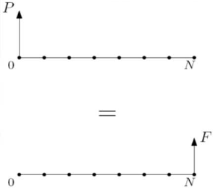

Compound Interest Factor - Single Cash Flow
Objective
Compute the mathematical equivalence between single cash flows, $P$ and $F$, separated by $N$ interest periods with an interest rate of $i$.
$$F=P{\left(1+i\right)}^{N}$$
or
$$P=\frac{F}{{\left(1+i\right)}^{N}}$$

Slide 9
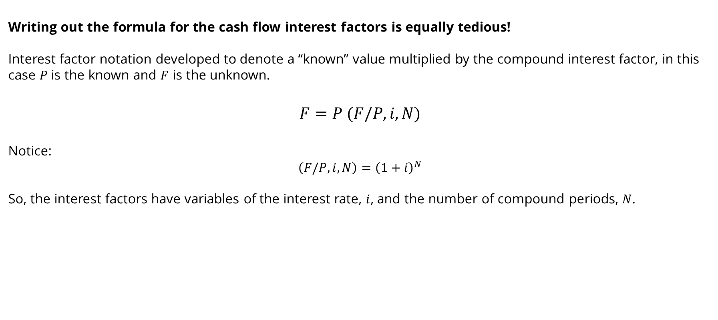
Interest Factor Notation
Writing out the formula for the cash flow interest factors is equally tedious!
Interest factor notation developed to denote a “known” value multiplied by the compound interest factor, in this case $P$ is the known and $F$ is the unknown.
$$F=P (F/P,i,N)$$
Notice:
$$\left(F/P,i,N\right)={\left(1+i\right)}^{N}$$
So, the interest factors have variables of the interest rate, $i$, and the number of compound periods, $N$.

Slide 10
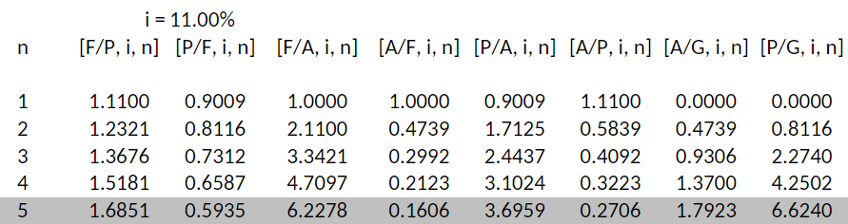
Interest Factor Tables
While the interest factor formula for the Present Worth Factor is quite simplistic, others are not so simple and can be very tedious.
Values of all compound interest factors have been calculated and presented in table format.

Slide 11
NEVER USE INTEREST FACTOR FORMULAS!!
INTEREST TABLES WERE CREATED FOR THE PURPOSE OF TIME EFFICIENCY AND SIMPLICITY
Notes:
Use the interest table factors up to 4 decimal places. Keep 4 decimal places in all mid-calculations, and only round to cents or dollars at the final answer.
Never use more decimal places.

Slide 12
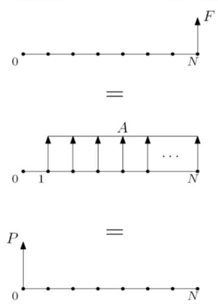
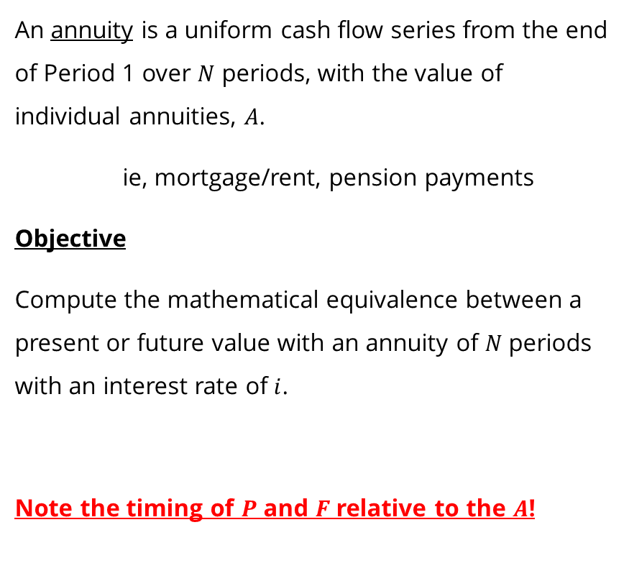
Compound Interest Factor – Annuity Cash Flow Series
An annuity is a uniform cash flow series from the end of Period 1 over $N$ periods, with the value of individual annuities, $A$.
ie, mortgage/rent, pension payments
Objective
Compute the mathematical equivalence between a present or future value with an annuity of $N$ periods with an interest rate of $i$.
Note the timing of $P$ and $F$ relative to the $A$!

Slide 13
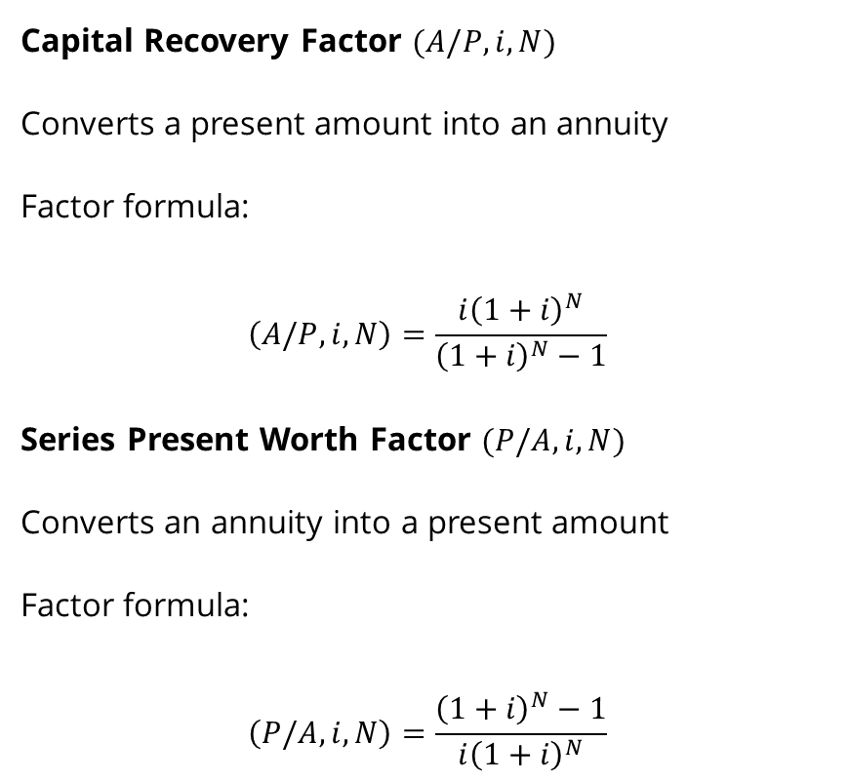
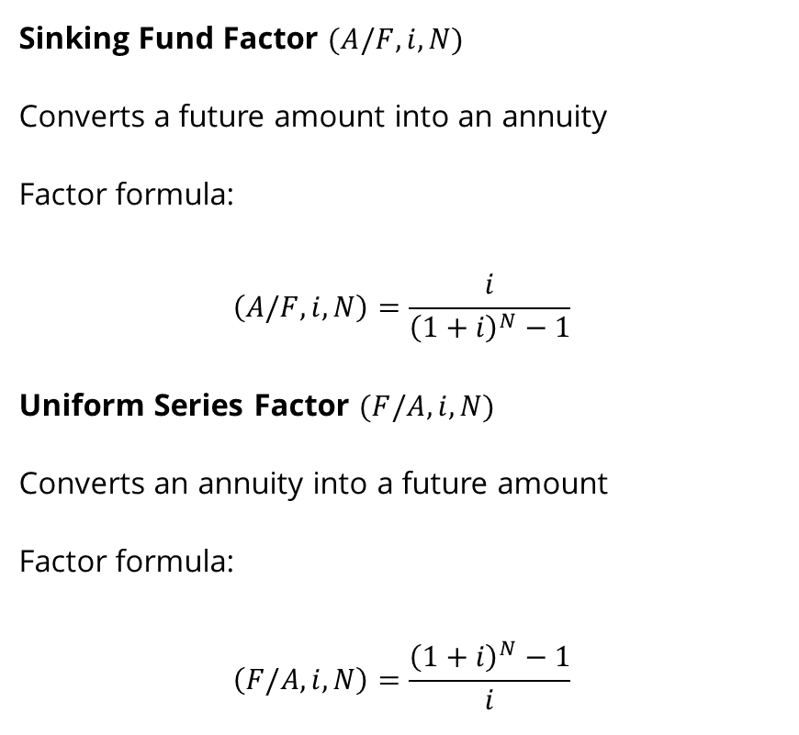
Compound Interest Factor – Annuity Cash Flow Series
Sinking Fund Factor $(A/F,i,N)$
Converts a future amount into an annuity
Factor formula:
$$\left(A/F,i,N\right)=\frac{i}{{\left(1+i\right)}^{N}−1}$$
Uniform Series Factor $(F/A,i,N)$
Converts an annuity into a future amount
Factor formula:
$$\left(F/A,i,N\right)=\frac{{\left(1+i\right)}^{N}−1}{i}$$
Capital Recovery Factor $(A/P,i,N)$
Converts a present amount into an annuity
Factor formula:
$$\left(A/P,i,N\right)=\frac{i{\left(1+i\right)}^{N}}{{\left(1+i\right)}^{N}−1}$$
Series Present Worth Factor $(P/A,i,N)$
Converts an annuity into a present amount
Factor formula:
$$\left(P/A,i,N\right)=\frac{{\left(1+i\right)}^{N}−1}{i{\left(1+i\right)}^{N}}$$

Slide 14

Series Present Worth as $N→∞$
Annuity factors assume that they end at a given point, but what happens if $N→∞$?
This only applies to the present value of an annuity.
Capitalized Value
Present value equivalent to an infinitely long uniform series of cash flows
Factor formula:
$$P=\lim_{N→∞}{A(P/A,i,N)}=A\lim_{N→∞}\left[\frac{{\left(1+i\right)}^{N}−1}{i{\left(1+i\right)}^{N}}\right]$$
$$P=\frac{A}{i}$$

Slide 15
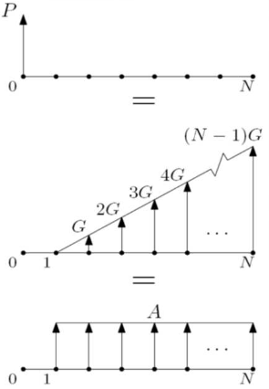
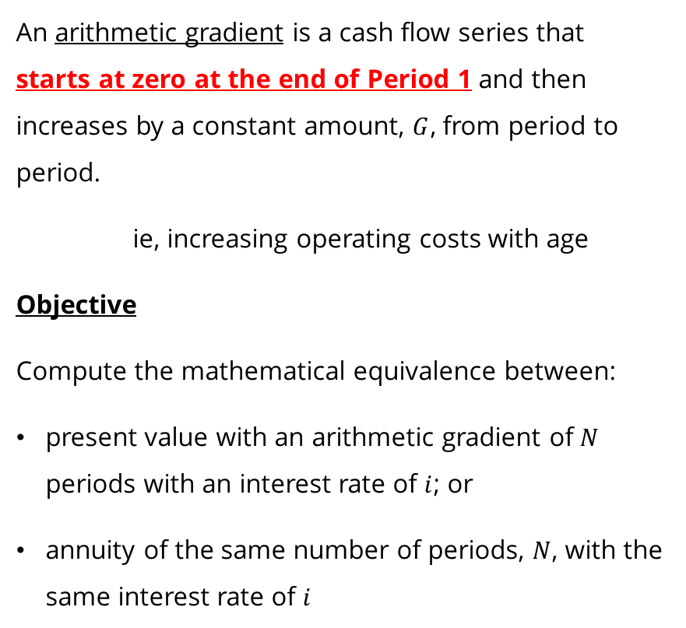
Compound Interest Factor – Arithmetic Gradient Cash Flow Series
An arithmetic gradient is a cash flow series that starts at zero at the end of Period 1 and then increases by a constant amount, $G$, from period to period.
ie, increasing operating costs with age
Objective
Compute the mathematical equivalence between:
present value with an arithmetic gradient of $N$ periods with an interest rate of $i$; or
annuity of the same number of periods, $N$, with the same interest rate of $i$

Slide 16
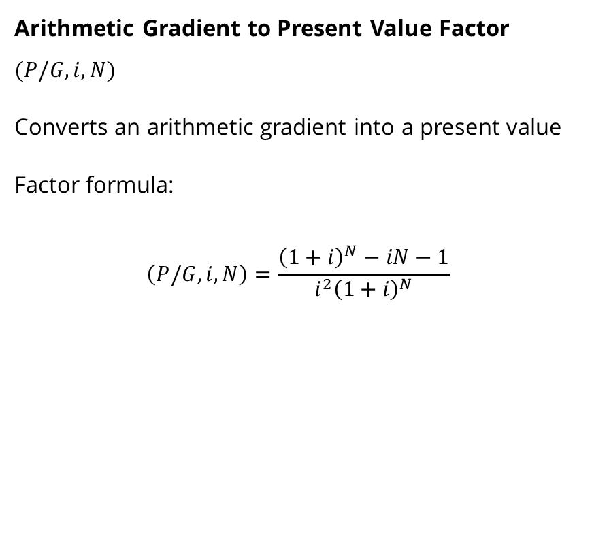

Compound Interest Factor – Arithmetic Gradient Cash Flow Series
Arithmetic Gradient to Annuity Factor $(A/G,i,N)$
Converts an arithmetic gradient into an annuity
Factor formula:
$$\left(A/G,i,N\right)=\frac{1}{i}−\frac{N}{{\left(1+i\right)}^{N}−1}$$
Arithmetic Gradient to Present Value Factor $(P/G,i,N)$
Converts an arithmetic gradient into a present value
Factor formula:
$$\left(P/G,i,N\right)=\frac{{\left(1+i\right)}^{N}−iN−1}{{i^{2}\left(1+i\right)}^{N}}$$

Slide 17
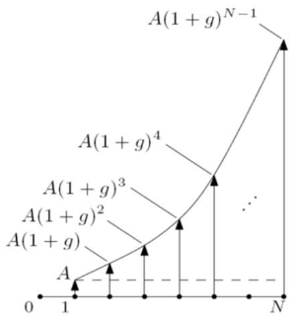
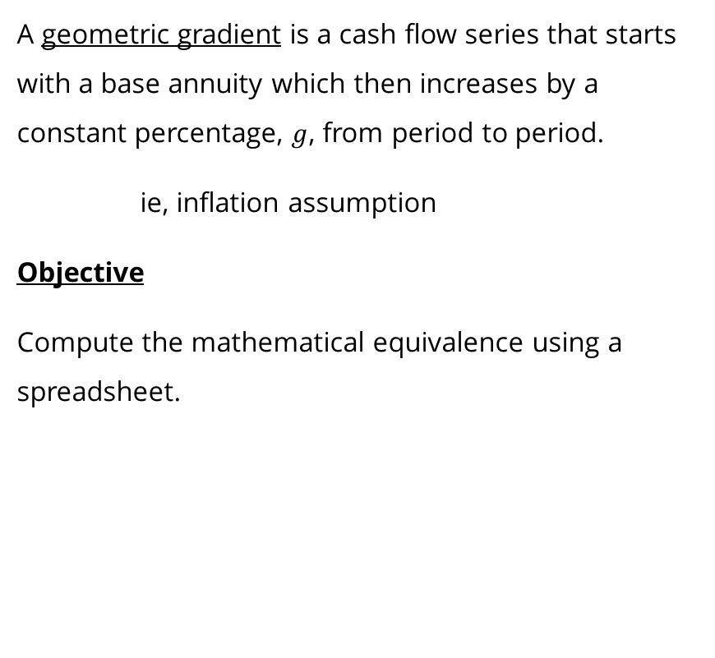
Compound Interest Factor – Geometric Gradient Cash Flow Series
A geometric gradient is a cash flow series that starts with a base annuity which then increases by a constant percentage, $g$, from period to period.
ie, inflation assumption
Objective
Compute the mathematical equivalence using a spreadsheet.
You will not need to calculate these in an exam for this course.

Slide 18
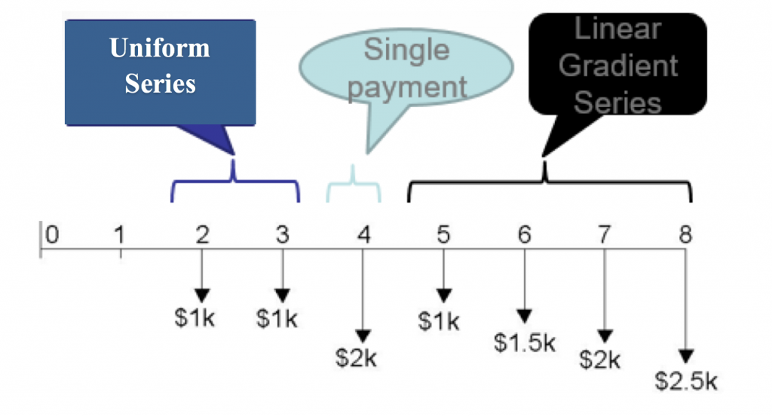
Non-Standard Cash Flows
When dealing with annuities and gradients, we assume that the compounding period is the same as the payment period.
If this is not true, take the extra steps to convert the sub-periods into an equivalent cash flow at the compounding period. (Or use a spreadsheet, in practice)
Our compound interest factors apply only in the specific structure that they are computed for. How do we deal with a cash flow diagram that may look like this:

Slide 19
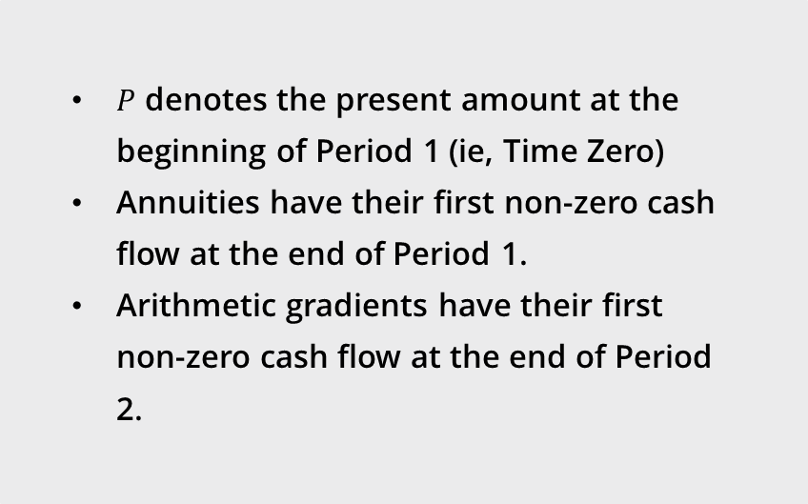
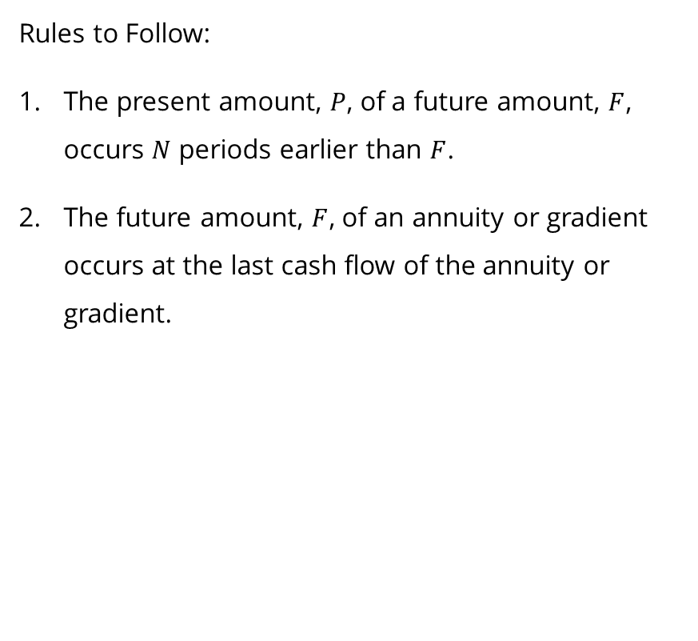
Summary and Rules to Follow
Rules to Follow:
The present amount, $P$, of a future amount, $F$, occurs $N$ periods earlier than $F$.
The future amount, $F$, of an annuity or gradient occurs at the last cash flow of the annuity or gradient.
$P$ denotes the present amount at the beginning of Period 1 (ie, Time Zero)
Annuities have their first non-zero cash flow at the end of Period 1.
Arithmetic gradients have their first non-zero cash flow at the end of Period 2.

Slide 20
AGAIN!!
NEVER USE INTEREST FACTOR FORMULAS!!

